Slide 1
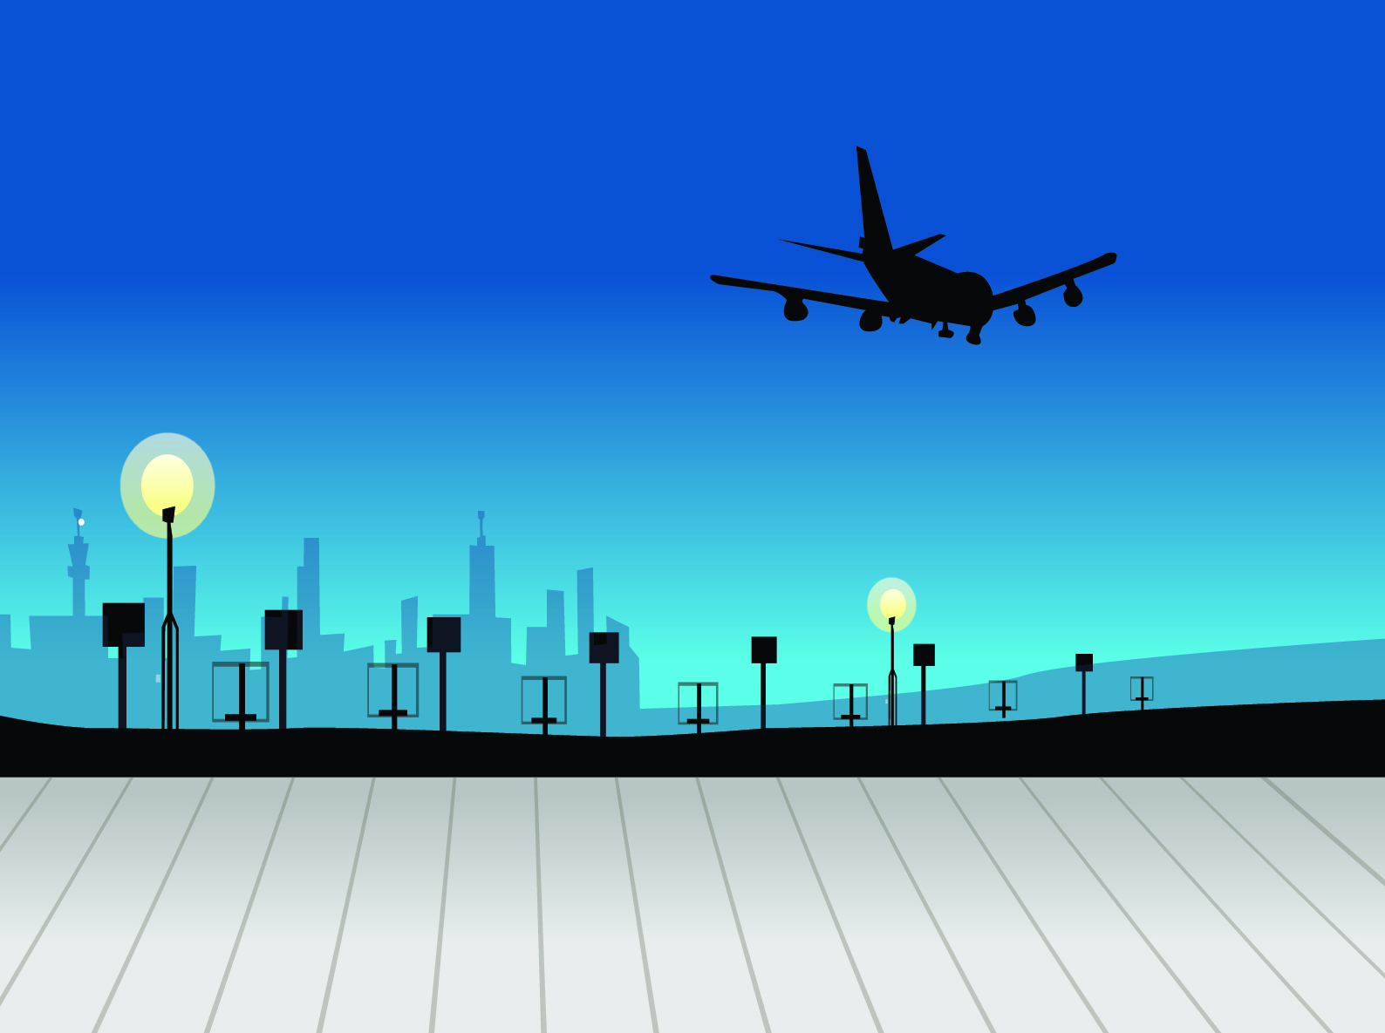


Montego Airline
Airline Safety
Presented by
Tushar Muley

Slide 2



Airline Phases
Off the Shelf Numbers
Montego Airline
Takeoffs and Initial Climb
2% of the time | Cause 14% of all fatalities | 6% of the 14% are onboard
Cursing
57% of the time | Causes 11% of all fatalities
Landing and Destination
4% of the time | Causes 46% of all fatalities

Slide 3



Fatalities by different Commercial Travel Modes
Comparing Commercial Travel
Montego Airline
287
36,096
268
Automobile fatalities are trending higher ever year
Train fatalities have risen in the last few years
Airlines fatalities are trending lower

Slide 4
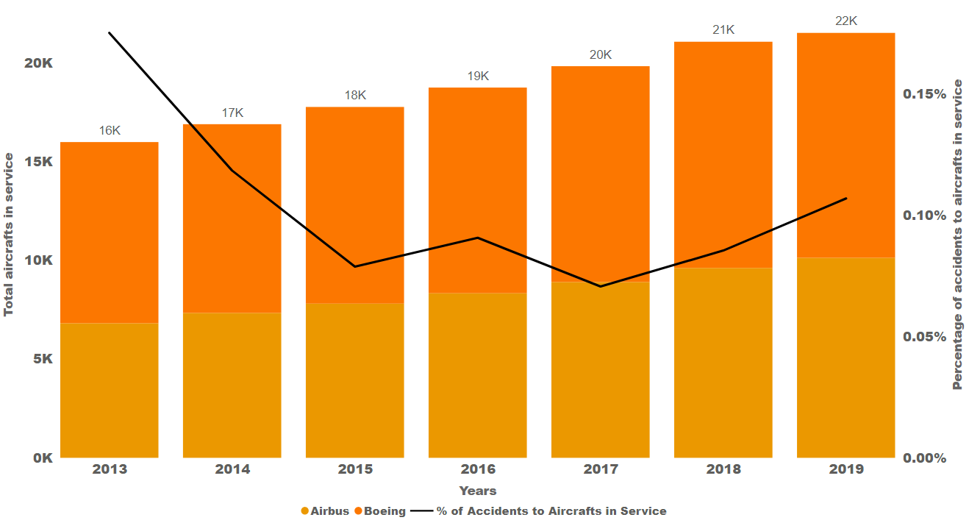
Airline Accidents by Manufacturer
Manufacturer Safety
Montego Airline
Accidents at there lowest rate of 0.12%
Over the last 6 years accidents are down while number of airlines is at the highest level in history

Slide 5
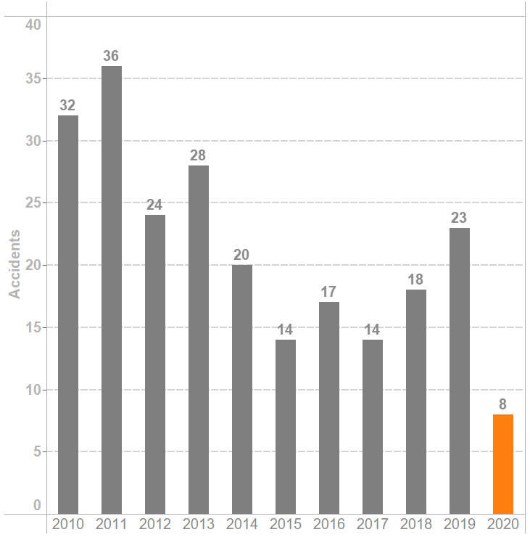

Number of Accidents in the Last 10 Years
Airline Related Accidents
Montego Airline
Historical low accidents
Overall trend has been reduction in accidents
Accident rate is 1.71 per million flights for 2020

Slide 6



Airline Safety Statics
By the Numbers Airline Travel
Montego Airline
4.5 Billion Passengers Safely Few in 2020
40.3 Million Flights Safely Flown in 2020
Accident rate down to 1.71 per million flights
1 in 18.56 Million the odds of being a accident in airplane
1 in 107 odds of being in a car accident

Slide 7
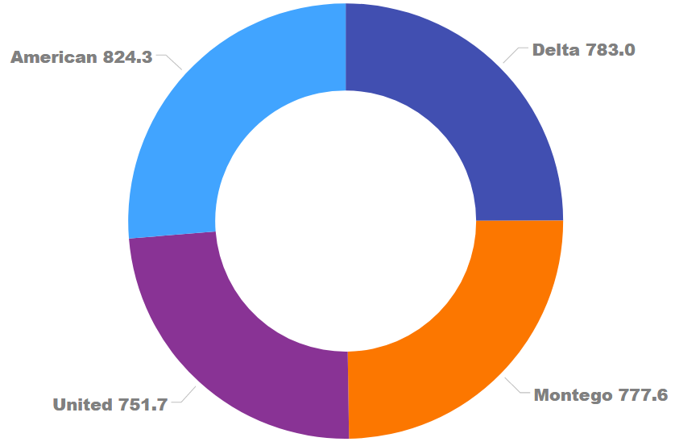
Top 4 Airlines Spent on Safety
Airline Spend on Safety
Montego Airline
3.13 Billion Total Spend on Safety
Third largest expenditure for airlines is on Safety
Airlines are expected to spend billions more on newer airlines to modernize their fleets

Slide 8

Final Comments
Montego Airline
Airline Travel still the safest way to travel

Slide 9

Montego Airline
Thank You.

